Slide 1
J.K.K.MUNIRAJAH COLLEGE OF TECHNOLOGY
DEPARTMENT OF
ELECTRONICS AND COMMUNICATION
ENGINEERING

Slide 2
IBM PROJECT
INTERNET OF THINGS
PHASE - 4
TEAM LEADER
RANJITH.B
TEAM MEMBER
SANTHIYA.Y
VENEESWARI.M
SATHASIVAN.R
SAKTHISIVAN.K
SUBASH.K

Slide 3
Introduction
Now we are in the era where not only the human being but also the things are connecting each other over the internet, gathering information, analyzing it and creating an action to help someone with a particular task is somewhat called internet of things (IOT). Recently one of the main areas of focus is environmental monitor and pollution research. Recent research has shown that air quality can have a drastic impact on long time health.
There are many aspects to air quality, gases may be present in the air, we breathe causing sickness. In between carbon monoxide (CO) plays a major role. So, in this project, I have tried to measure the amount of carbon monoxide (CO) in a particular area using MQ-7 and GPS sensor, ARDUINO as a client to collect the data from the sensor, by using a serial connection to Raspberry Pi with the help of node-RED transferred the data to IBM cloud.

Slide 4
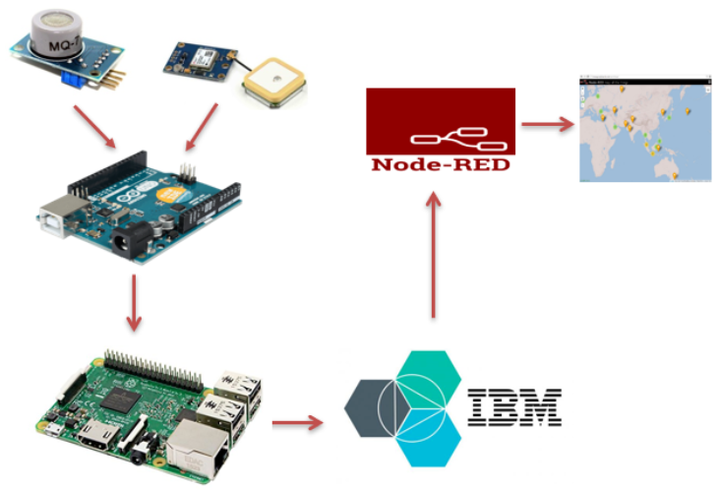
IBM cloud dashboard we have visualized the data for a specific place show

Slide 5
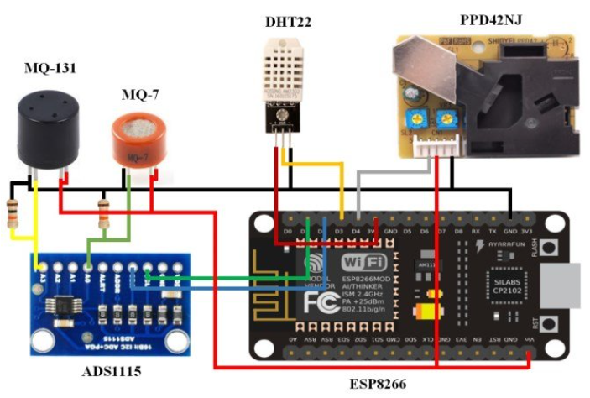
The Hardware Components

Slide 6
IOT Based Air Quality Monitoring System
Using Node –RED;
The design and development of the system that uses sensors to sense the presence of harmful gasses and compounds in the air, conductivity of water while constantly transmitting this data to a microcontroller, ESP8266 is presented.
The integrated system could possibly be a big yes for the smart cities to justify steps to control pollution level in the years to follow, in terms of small size, efficient power usage and cost

Slide 7
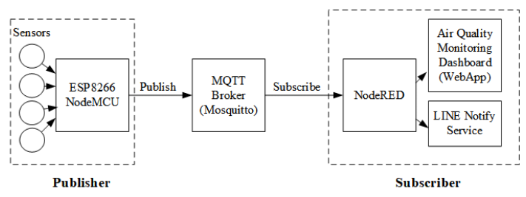
IBM and Node-RED architecture
Blue mix is a cloud platform operated by IBM with a wide range of ready-made services, application and APIs, allowing the user to quickly create their own application architecture. In this project, the platform is used for managing the devices and storing and visualizing the sensor data.

Slide 8
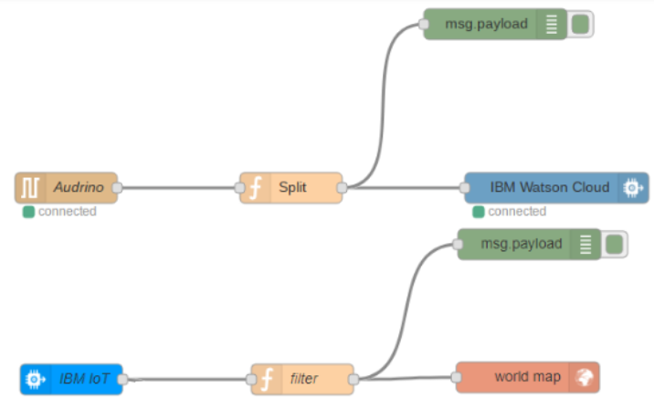
After collecting the data by using ARDUINO IDE with a specific format, sent it to the Raspberry Pi window using a serial cable. Here Raspberry Pi has been used as a server where all the data from different sources can be managed and split it in exact format to send the IBM cloud.

Slide 9
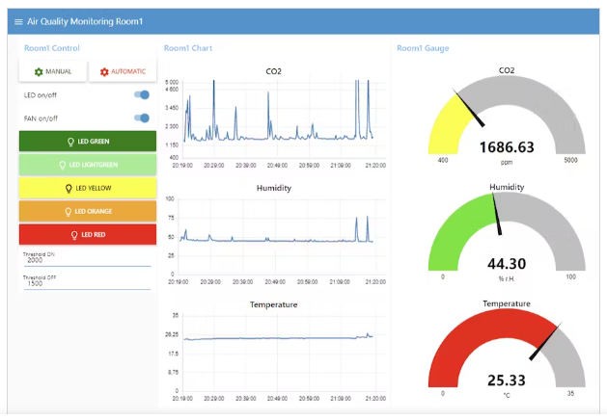
That the sensor data has collected from the IBM cloud nodes and sent it to the Node-RED world map window after filtering in the right format to show the values in map with exact position and CO values.

Slide 10
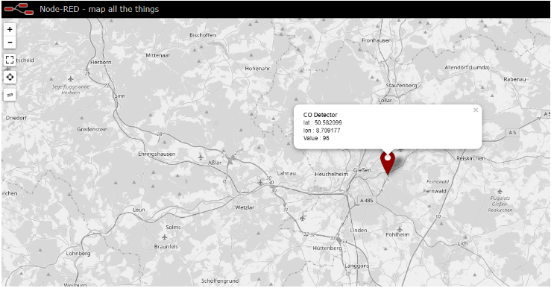
The final world map, sensor data is visualized in Node-RED window.

Slide 11
Conclusion and future work
In this project, a flexible solution was developed for collecting CO values from the atmosphere. The data will be ready and combined with GPS coordinates before being sent it to the IBM Blue mix cloud platform, where it is stored in the cloud ant NOSQL database for later analysis.
Although in this project serial connection has been used between raspberry Pi to ARDUINO. Perhaps, in near future (Lora, Wi-Fi) can be used. In the Node-RED map window fig. (4), different can be implemented to demonstrate the density of the CO in the atmosphere (Red=critical, Green= low level of CO). In case of a critical situation, it's also possible to display the alarm in a particular location to create awareness among the people.

Slide 12
THANKYOU

